Slide 1

Ethereum Price Prediction using Time2Vec + LSTM
by Stanley Tran
Github: https://github.com/virtualspark/time2vec_ethereum

Slide 2

Agenda
Introduction
Understanding Ethereum
Technologies used: Time2Vec + LSTM
Model Implementation
Insights and improvement initiatives
References

Slide 3

Introduction
Time is an important features
Time series forecasting is used to predict future values based on previously observed values
Examples: predicting stock movements, daily sales of a company, songs that a person is interested based of their listening history
In this project, we discuss how to predict the price of Ethereum using Time2Vec + LSTM

Slide 4

Understanding Ethereum
Second largest cryptocurrency after Bitcoin
Decentralized, open-source blockchain with smart contract functionality
Used to create and share business, financial services, and entertainment applications (e.g. Non-fungible tokens)
Known as the “world’s programmable blockchain”

Slide 5


Technologies used: Time2Vec + LSTM
Time2Vec is a representation of time for modeling sequential data
Based on the following aspects:
Capture periodicity and non-cyclical modes
Time zoom constant
Easy to integrate with other models
Defined as follow:
t2v(τ) : Time2Vec of τ (scalar notion of time) is a vector of size k + 1
k: number of sinusoids (modelling the periodicity in your dataset)
i: index of the k + 1 dimensional vector. Varies between 1 and k, 0th being the linear term
F: periodic activation function. Sine function is chosen for this.
ωi and ϕi: learnable parameters
The entire vector is k (from sinusoids) + 1 (from linear term) dimensional vector
The sine function in Time2Vec can be used to capture periodic patterns while the linear term for non-periodic pattern.
We will be using Time2Vec + LSTM to predict Ethereum price

Slide 6


Model Implementation
Part 1: Extracting data of Ethereum using Yahoo Finance
Part 2: Preprocessing the data using MinMaxScaler
The goal of normalization is to change the values of numerical columns in the data set to a common scale without distorting differences in the ranges of values

Slide 7
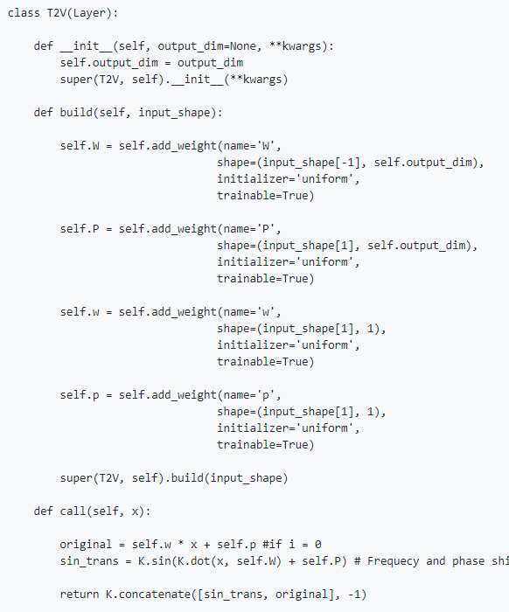
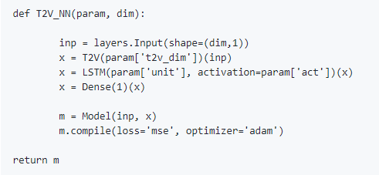
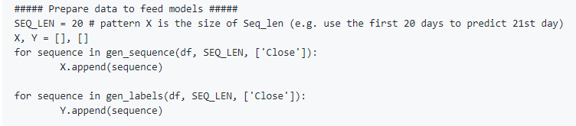
Model Implementation
Part 3: Define the Time2Vec + LSTM model. Generate sequence and labels to prepare data to feed in the model and perform train and test split.
This is the model building stage. It takes several attempts to get the right model to use and the choice of the sequence length.
Sequence length:
[ 1, 2, 3, 4, 5 ] –> [6]
[ 2, 3, 4, 5, 6 ] –> [7]
[ 3, 4, 5, 6, 7 ] –> [8]
[ 4, 5, 6, 7, 8 ] –> [9]
[ 5, 6, 7, 8, 9 ] –> [10]

Slide 8

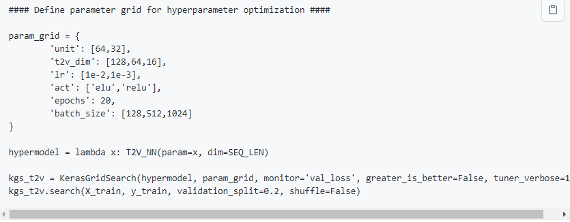
Model Implementation
Part 4: Use KerasGridSearch to find the best parameters (with the best score) to use for the Time2Vec + LSTM model
Hyperparameters optimization is a big part of deep learning.
Using KerasGridSearch enables you to find the best hyperparameters to tune your model.

Slide 9

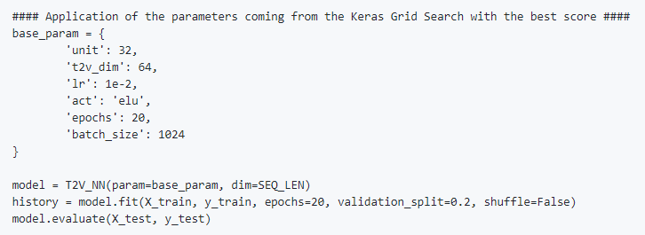
Model Implementation
Part 5: Apply the best parameters in the Time2Vec + LSTM model

Slide 10
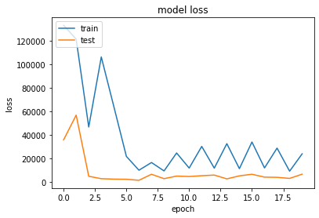
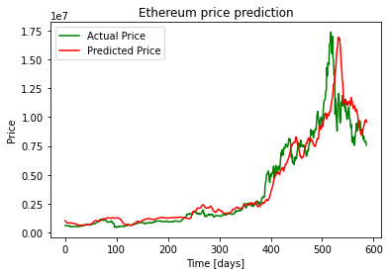
Model Implementation
Part 6: Display the model loss with training and testing sets in plt graph
To see if the loss had been reduced when we trained our model after several epochs
Part 7: Display the actual and the predicted price in plt graph
To observe the actual price vs the predicted price

Slide 11

Insights and improvement initiatives
Time2Vec and LSTM are excellent technologies
Great usage to analyze and predict time-series information
Comes with its own challenges
Complex and hard to handle objects
Great chance that model can overfit
Improvements to consider:
Build forecast function to predict the prices for the next few days, few months or years
Try testing with other cryptos data (Bitcoin, Litecoin, Dogecoin,…)
Build an application and deploy in GCP

Slide 12

References
Reseach Papers
https://arxiv.org/pdf/1907.05321.pdf
https://openreview.net/attachment?id=rklklCVYvB&name=original_pdf
Kaggle codes
https://www.kaggle.com/danofer/time2vec-water-levels
Github codes
https://github.com/email81227/Time2Vec-TensorFlow2/tree/master/Time2Vec
https://github.com/cerlymarco/keras-hypetune
https://github.com/tensorflow/addons/issues/2508
https://github.com/cerlymarco/MEDIUM_NoteBook/blob/master/Time2Vec/Time2Vec.ipynb
Towards Data Science articles
https://towardsdatascience.com/neural-networks-with-sine-basis-function-c5c13fd63513 (paper on sine basis function)
https://towardsdatascience.com/time2vec-for-time-series-features-encoding-a03a4f3f937e

